Slide 1

Netflix Group 3 Midterm Project:
Data Extraction & Analysis of Diabetes Dataset
By:
Mahederemariam Dagne
Napoleon Davis II
Elliott Einstein

Slide 2


Table of Contents
01
02
03
Dataset & Cleanup
Data Extraction & Transformation
Quality Assurance Test
04
05
06
Conclusion
ETL Migration to Cloud
Research Questions and Findings
07
08
Future Considerations
Problems & Limitations

Slide 3


01
Dataset & Cleanup
Notes:
Elliot

Slide 4
Diabetes Facts
Diabetes
Prediabetes
Death
37 MILLION PEOPLE
96 MILLION PEOPLE
7th Leading
28.7 MILLION PEOPLE
26.4 MILLION PEOPLE
Have diabetes (11.3% of the US population as of 2021
Aged 18 years or older have prediabetes (38.0% of the adult US population)
Diabetes was the seventh leading cause of death in the US in 2019
Including 28.5 million adults are diagnosed and 8.5 million people or 23.0% of adults are undiagnosed.
Aged 65 years older (48.8% of the 65+ US population ) have prediabetes
Notes:
Elliot

Slide 5


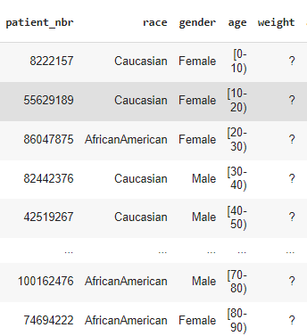
Diabetes Dataset
UC Irvine ML Dataset
1999 - 2008
10 years (1999-2008) of clinical care at 130 US hospitals and integrated delivery networks
50 columns
101766 rows
Notes:
#Elliot
(1) It is an inpatient encounter (a hospital admission).
(2) It is a diabetic encounter, that is, one during which any kind of diabetes was entered to the system as a diagnosis.
(3) The length of stay was at least 1 day and at most 14 days.
(4) Laboratory tests were performed during the encounter.
(5) Medications were administered during the encounter.
The data contains such attributes as patient number, race, gender, age, admission type, time in hospital, medical specialty of admitting physician, number of lab test performed, HbA1c test result, diagnosis, number of medication, diabetic medications, number of outpatient, inpatient, and emergency visits in the year before the hospitalization, etc.

Slide 6
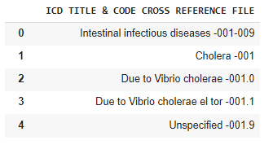
ICD-9 Diagnosis and Procedure Codes Dataset
ICD 9 codes are official code assigning systems for diagnoses and procedures associated with hospital utilization in the United States.
1 column
5622 rows
Notes:
#Elliot

Slide 7
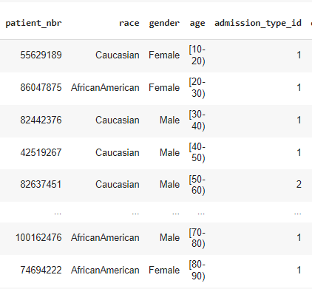
Cleaning
Cleaned UC Irvine ML Dataset
Dropped null rows
Removed duplicates
Removed empty columns
Notes:
Elliot

Slide 8
02
Data Extraction & Transformation
Notes:
Napoleon

Slide 9
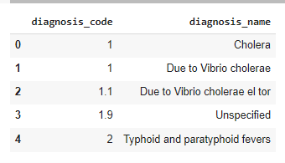
Data Extraction & Transformation
Extracted normalized tables from the master dataset.
Created numeric ids for medication types
Changed column to rows and added them to a new table
Split ICD codes and removed characters
Notes:
Napoleon

Slide 10
03
Quality Assurance Test
Notes:
Napoleon

Slide 11
Quality Assurance
Verified split tables included all the datasets in the master table
Tested the types of medication were the same as the columns we extracted them from
Verified number of columns
Notes:
Napoleon

Slide 12
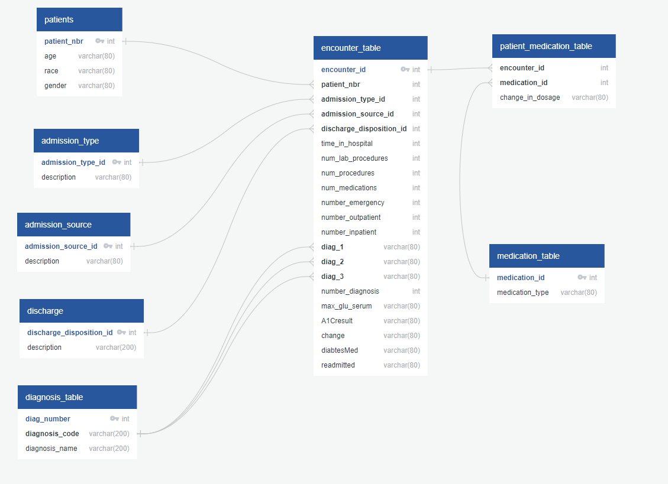
ERD Diagram of Final Dataset
Notes:
#Napoleon

Slide 13
04
ETL Migration to Cloud
Notes:
Napoleon

Slide 14
Parquet and Cached files
query # | local_machine | pyspark | pyspark_parquet | pyspark_cached
query_1 | 0.10 sec | 8.16 sec | 1.05 sec | 1.19 sec
query_2 | 0.14 sec | 6.34 sec | 1.17 sec | 1.14 sec
query_3 | 0.12 sec | 24.60 sec | 16.26 sec | 14.25 sec
query_4 | 15.07 sec | 12.59 sec | 3.22 sec | 3.18 sec
Question # | Local Machine (PostgreSQL) | Pyspark | Parquet Pyspark | Cached Pyspark
1 | .10 | 7.76 | 1.05 | 1.19
2 | .14 | 6.34 | .77 | .74
3 | .12 | 23.80 | 15.86 | 14.25
4 | 15.07 | 12.59 | 3.22 | 2.78
Note: Time is in seconds
Notes:
#Napoleon

Slide 15
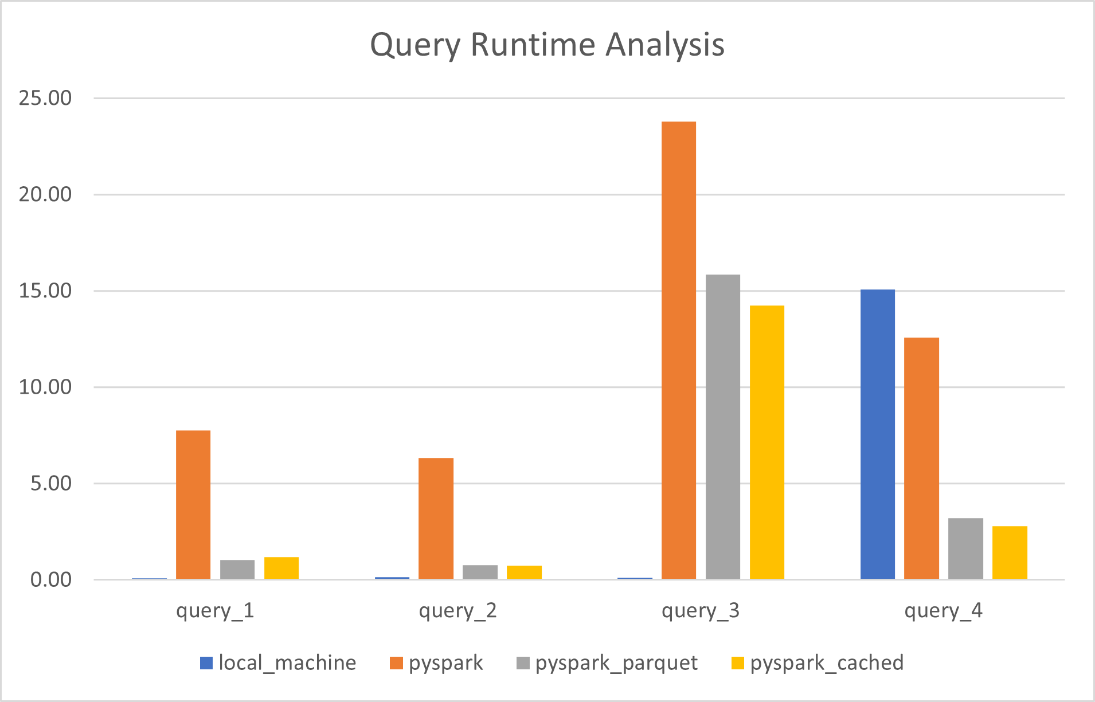
Notes:
#Napoleon

Slide 16
05
Research Questions and Findings
Notes:
#Mahi

Slide 17
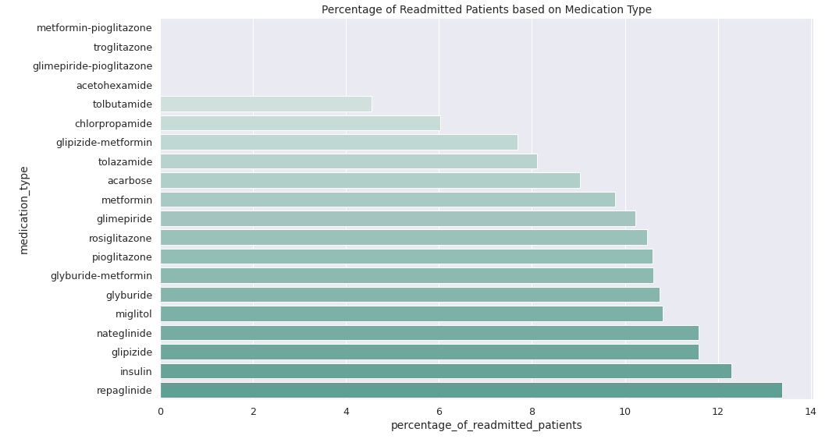
Question 1: Which medication type had the least percentage of patients that were readmitted?
Notes:
#Mahi

Slide 18
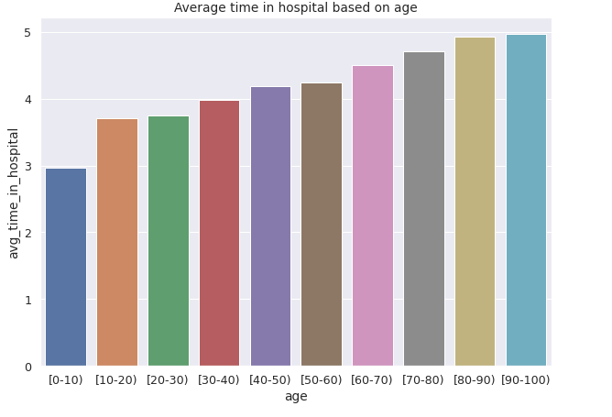
Question 2: Which Age group on diabetes medication spent the least amount of time in the hospital?
Notes:
#Mahi

Slide 19
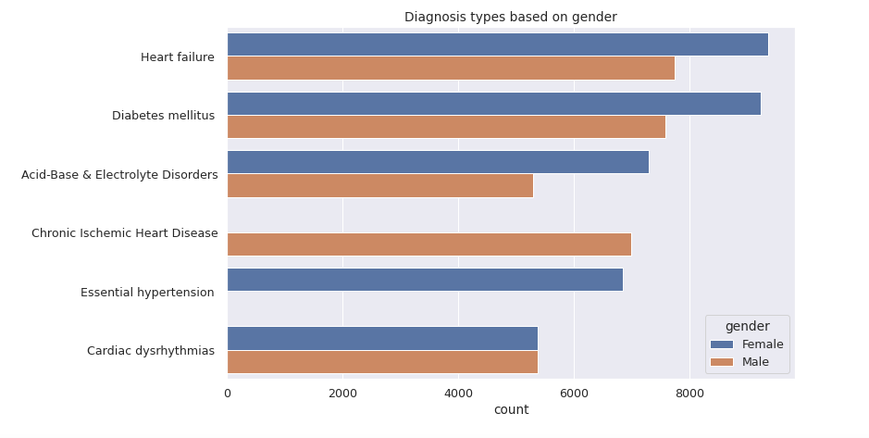
Question 3: Which Diabetes diagnosis group have the highest number of diagnosis based on gender
Notes:
#Mahi

Slide 20
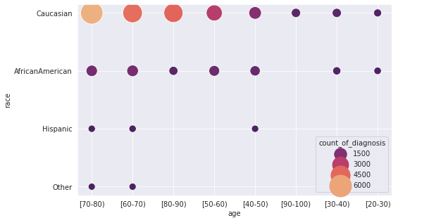
Question 4: Which age group and race had the highest number of diagnosis and readmitted patients within 30 days?
Notes:
#Mahi

Slide 21
06
Conclusion
Notes:
Mahi

Slide 22
Parquet files are much faster to work with when handling larger datasets.
Understanding initial data is important for splits
Assert statements allow minimization of errors
In general diagnosis types are mostly not related to gender
Notes:
Mahi

Slide 23
07
Future Considerations
Notes:
Mahi

Slide 24
Future Considerations
Predict whether or not a patient has diabetes using this dataset as training model.
In-depth analysis on the cost and effect of medications.
Notes:
Mahi

Slide 25
08
Problems & Limitations
Notes:
Elliot

Slide 26
Problems & Limitations
Splitting on multiple conditions
Deciding on the number of tables and the relationships between them in the logical design phase
Adopting pandas to pyspark framework
Notes:
Elliot

Slide 27
Thank You!!!

